Slide 1
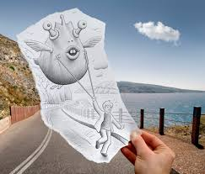
Surreal Digital vs. Drawing

Slide 2
Having Art block? Check out some examples from Ben Heine’s website!
http://www.benheine.com
Go to projects> Pencil vs. Camera

Slide 3
How to get started
Find a background- Make sure it is copyright free, clear and of good quality (not pixelated)
Turn it in on Google Classroom (“Background Photos for Interactive Drawings”)
Take a piece of tracing paper and rip the edges
Trace all of the background showing through to paper
Add your Surreal elements
Add FULL RANGE of VALUE
Carbon the paper to trace the design on a white sheet of paper

Slide 4
How to add the image to your background in Photoshop
Go File- Open
Open your Background and your drawing (they will automatically open in different windows
Click on the quick selection tool and select your drawing and hand ONLY (Not the black in the background)
Drag it to your other layer using MOVE Tool

Slide 5
Paste drawing into your background
Press Ctrl+T to resize and move your drawing to the correct location
Make sure it matches up with the lines on the background

